Slide 1
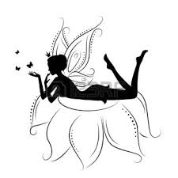

Alice the Fairy
Story by David Shannon

Slide 2

My name is Alice and I’m a fairy!
I am a temporary fairy not a permanent fairy.

Slide 3
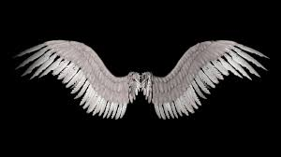
I have wings so that I can fly but I can’t fly very high yet.

Slide 4
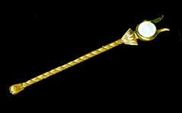
This is my wand…
Fairies use their wands to change frogs into princes.

Slide 5
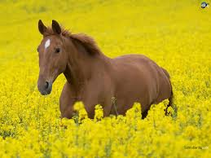
I changed my dad into a horse.

Slide 6
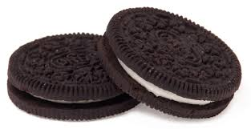
One time my mom made cookies for my dad so I turned them into mine.

Slide 7
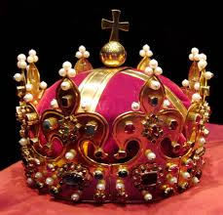
I decided to make him an outfit because I ate his cookies. Instead I made him a crown.

Slide 8

With my magic wand I can make leaves fall from trees.

Slide 9

Sometimes I use my magic wand to disappear.

Slide 10
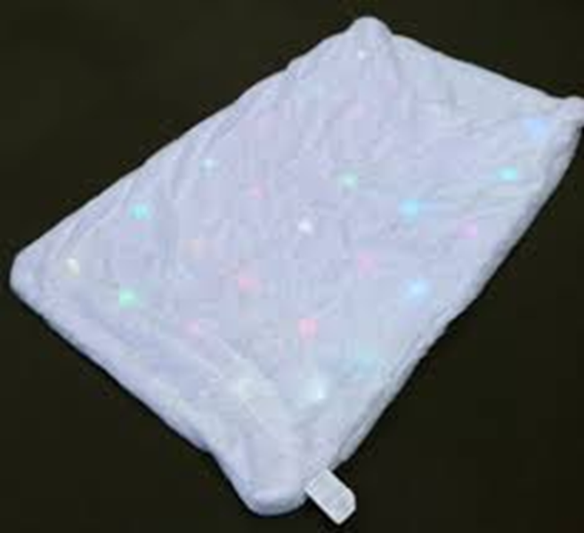
But that is kind of scary so use my blanket to disappear.

Slide 11

My magic mirror told me that I am the fairiest of them all.

Slide 12

Fairy dust is very useful, I use it to turn oatmeal into cake.

Slide 13
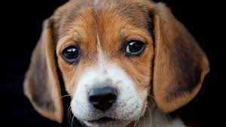
Casting spells is very important. Watch me make my dog float on the ceiling…
Hocus Pocus
Croakin Docus!

Slide 14

But a fairy must be very careful with magic. Once I turned my white dress into a red one. That made the Duchess so mad that she locked me in the tower!

Slide 15
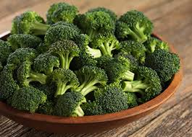
A fairy’s life is filled with danger… like broccoli poisoned by the wicked Duchess!

Slide 16

I’m suppose to learn how to make clothes get up off the floor and dance around and line up in the closet.

Slide 17

I’m not very good at tricks and casting spells so I will probably stay a temporary fairy forever.

