Slide 1
Corduroy
By Don Freeman

Slide 2
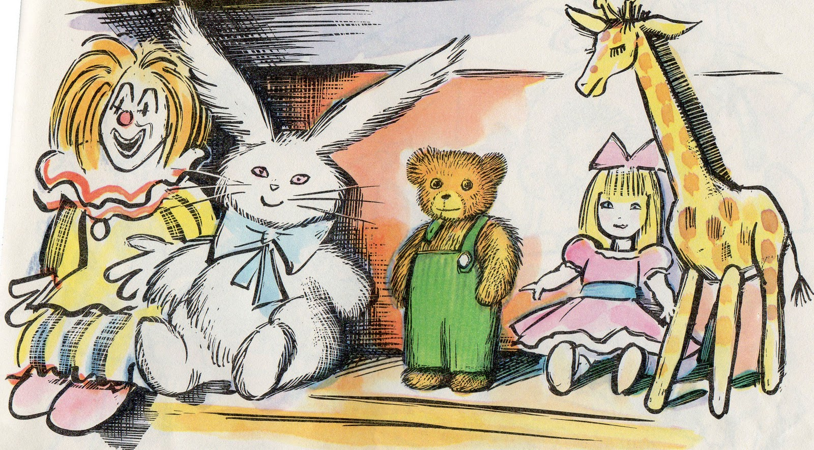
Corduroy is a bear who once lived in the toy department of a big store. Day after day he waited for someone to take him home.

Slide 3
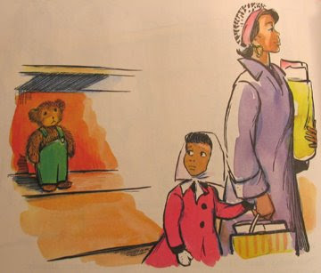
One morning a girl said, “Look! There’s the very bear I have always wanted. “Not today, dear.” Her mother sighed. “He doesn’t look new. He’s lost a button to his shoulder strap.”

Slide 4
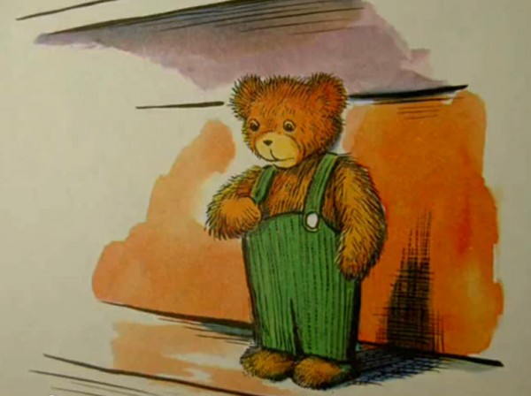
“I didn’t know I’d lost a button,” he said to himself. “Tonight I will go and see if I can find it.”

Slide 5
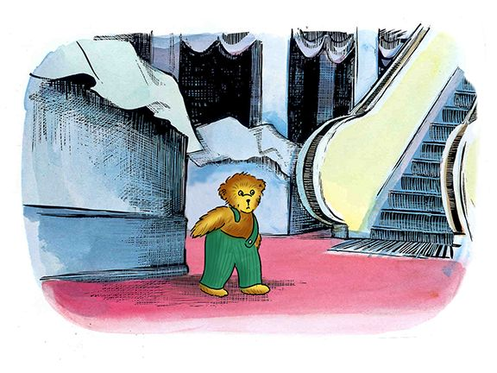
After everyone left, Corduroy climbed down from the shelf and went to look for his button.

Slide 6
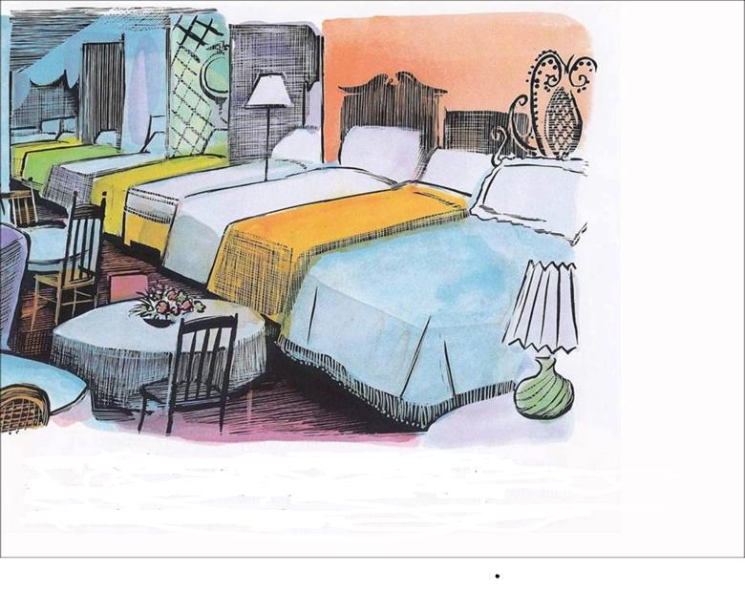
On the next floor, Corduroy saw an amazing sight-chairs, lamps, sofas and rows and rows of beds.

Slide 7
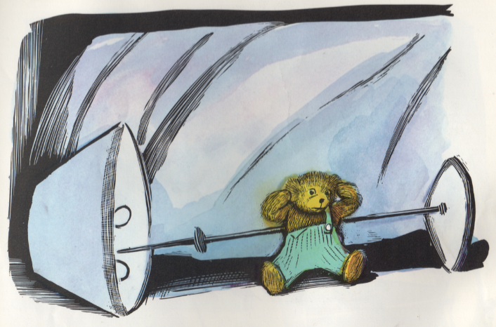
“Why, here’s my button!” he cried. He yanked and pulled until POP! Off came the button-and off the mattress Corduroy toppled into a lamp. Bang!

Slide 8
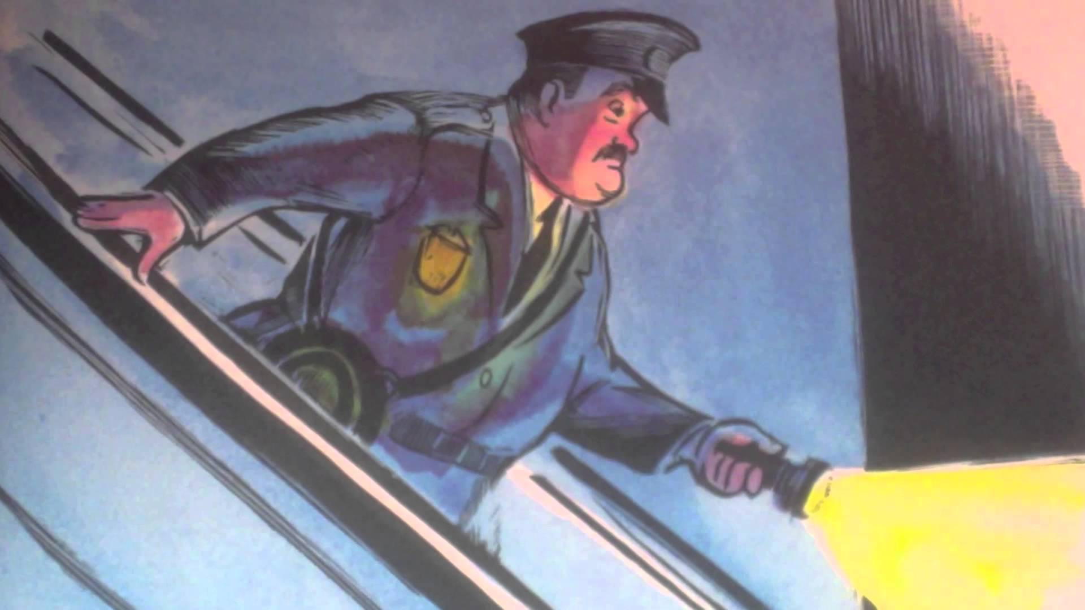
A night watchman heard the crash and came dashing down the escalator.

Slide 9
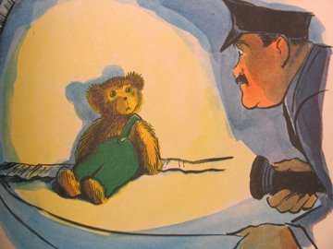
He flashed his light until he saw two fuzzy brown ears sticking up from under the covers. “How did you get upstairs?” he asked. He tucked Corduroy under his arm and carried him back to the shelf.

Slide 10
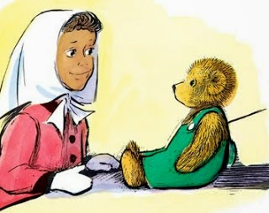
The next morning, Corduroy woke up and there was the girl from the day before. “Last night I counted what I’ve saved in my piggy bank and my mother said I could bring you home.”

Slide 11
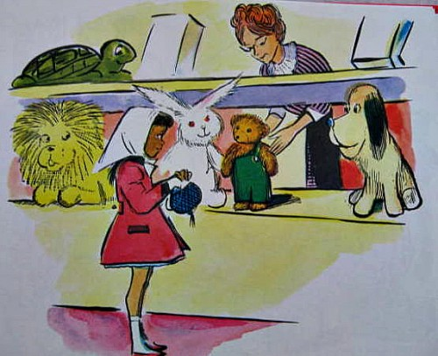
“Shall I put him in a box for you?” the saleslady asked. “No thank you,” Lisa answered. And she carried Corduroy home in her arms.

Slide 12
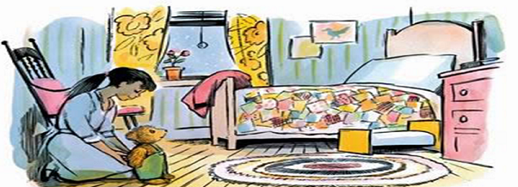
Corduroy saw a girl-sized bed and a bed just the right size for him. “This must be home,” he said. “I’ve always wanted a home.”

Slide 13
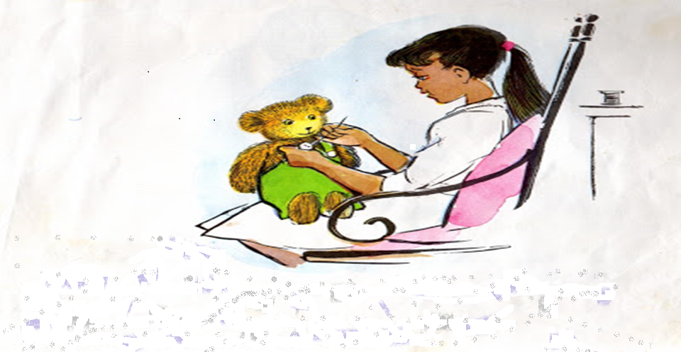
Lisa sat down and began to sew Corduroy’s button on his overalls. “I like you the way you are,” she said, “but you’ll be more comfortable with your strap fastened.”

Slide 14
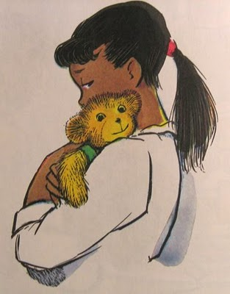
“You must be a friend,” said Corduroy. “I’ve always wanted a friend.” “Me too!” said Lisa, and gave him a big hug.

Slide 15
THE END

