Slide 1
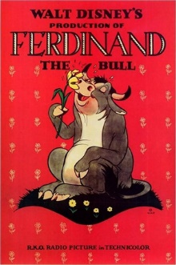
THE STORY of FERDINAND
by MUNRO LEAF

Slide 2
Once upon a time in Spain

Slide 3
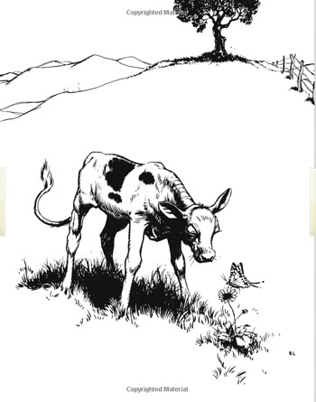
there was a little bull and his name was Ferdinand.

Slide 4
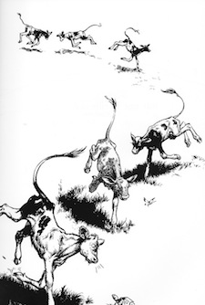
All the other little bulls he lived with would run and jump and butt their heads together, but not Ferdinand.

Slide 5
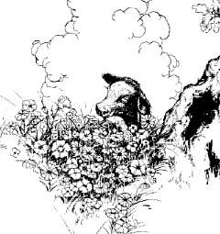
He liked to sit just quietly and smell the flowers.

Slide 6
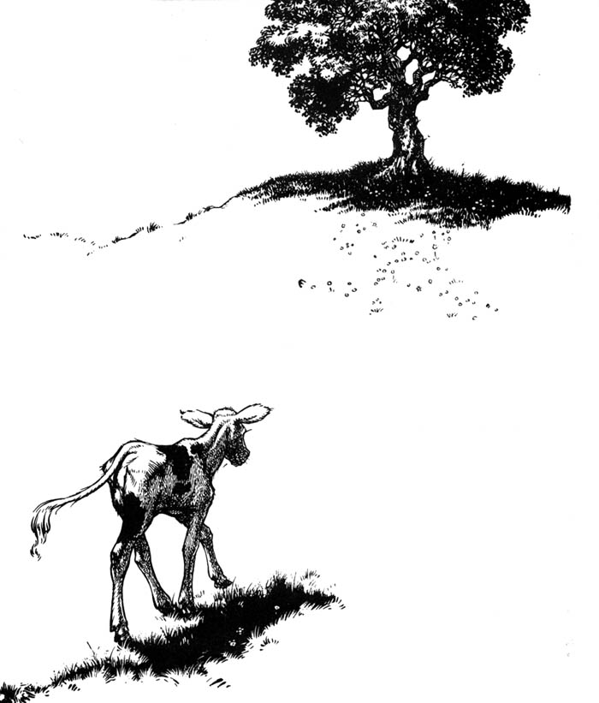
He had a favorite spot out in the pasture under a cork tree.

Slide 7
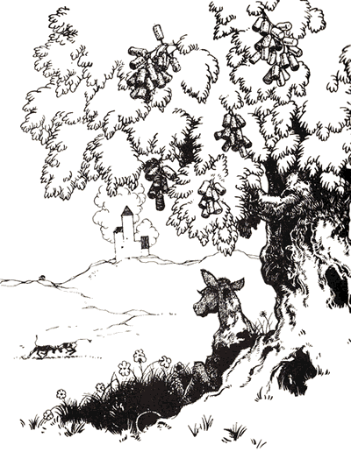
It was his favorite tree and he would sit in its shade all day and smell the flowers.

Slide 8
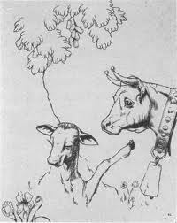
Sometimes his mother, who was a cow, would worry about him. She was afraid he would be lonesome all by himself.

Slide 9
“Why don’t you run and play with the other little bulls and skip and butt your head?” she would say.
But Ferdinand would shake his head. “I like it better here where I can sit just quietly and smell the flowers.”

Slide 10
His mother saw that he was not lonesome, and because she was an understanding mother, even though she was a cow, she let him just sit there and be happy.

Slide 11
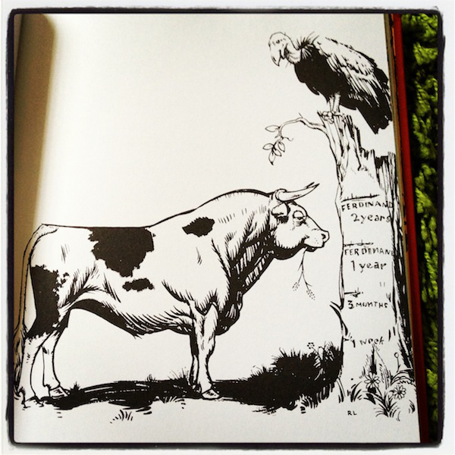
As the years went by Ferdinand grew and grew until he was very big and strong.

Slide 12
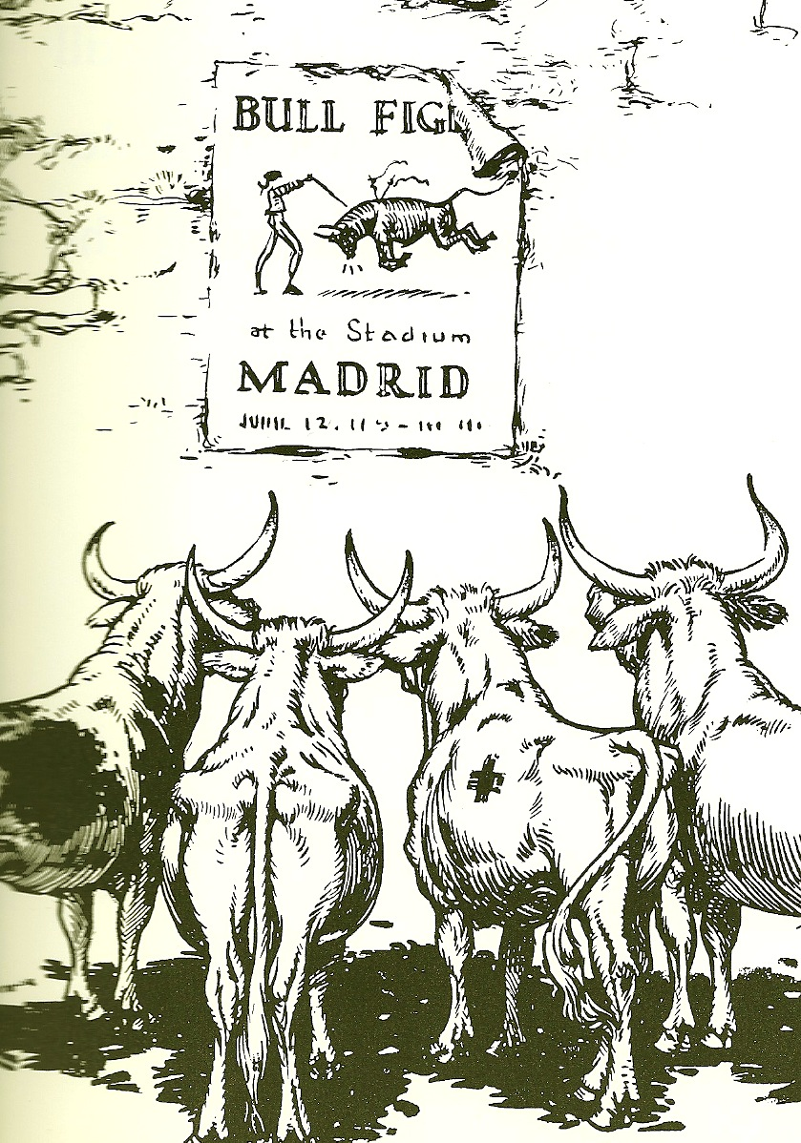
All the other bulls who had grown up with him in the same pasture would fight each other all day. They would butt each other and stick each other with their horns. What they wanted most of all was to be picked to fight at the bull fights in Madrid.

Slide 13
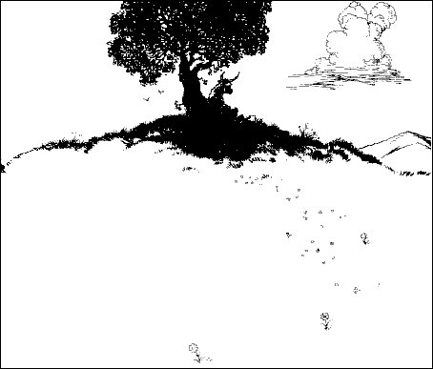
But not Ferdinand --- he still liked to sit just quietly under the cork tree and smell the flowers.

Slide 14
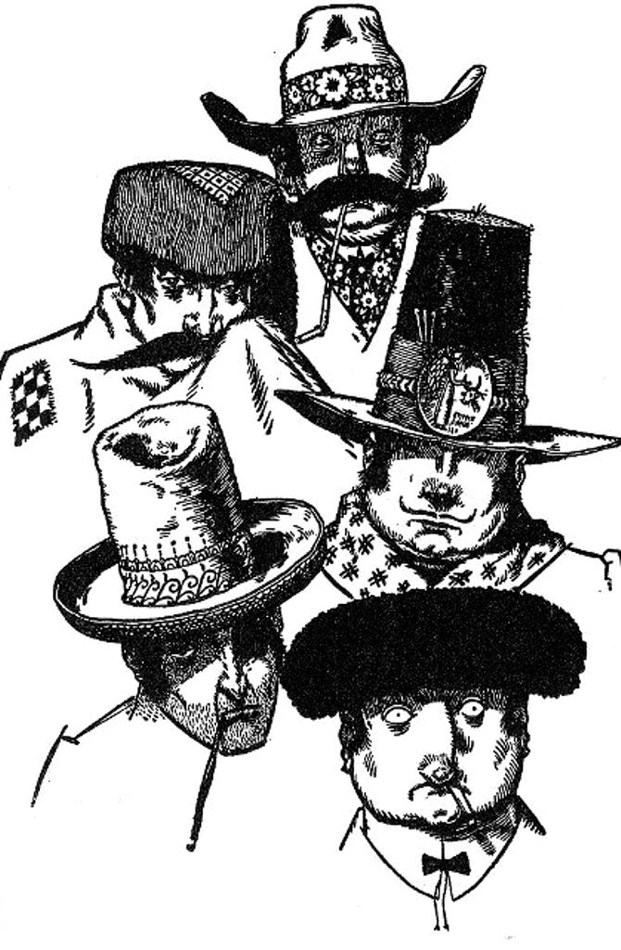
One day five men came in very funny hats to pick the biggest, fastest, roughest bull to fight in the bull fights in Madrid.

Slide 15
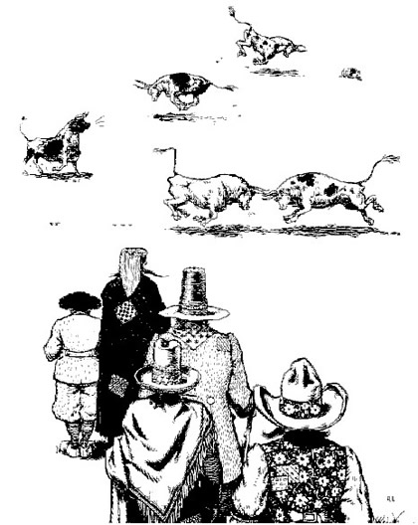
All the other bulls ran around snorting and butting, leaping and jumping so the men would think that they were very very strong and fierce and pick them.

Slide 16
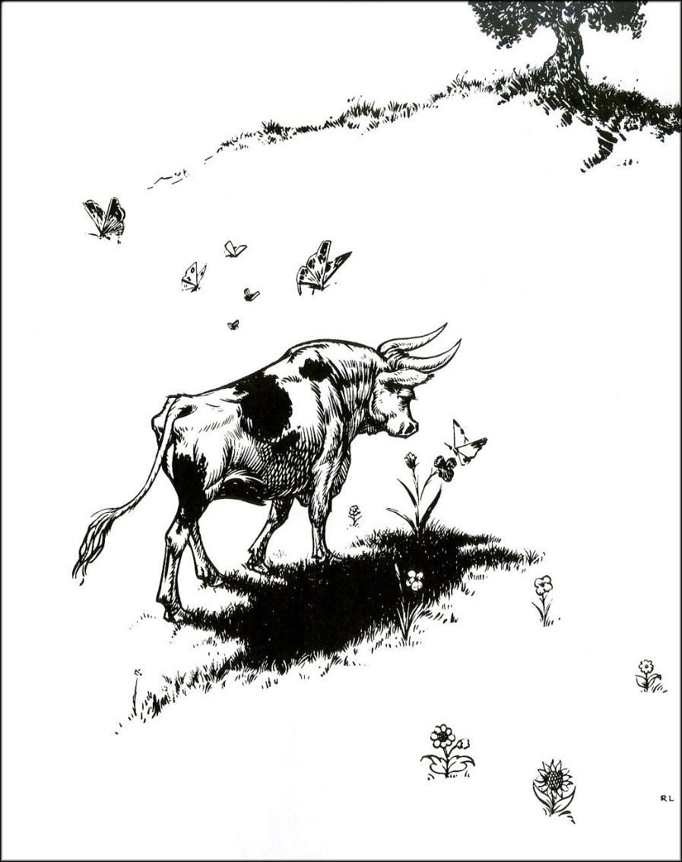
Ferdinand knew that they wouldn’t pick him and he didn’t care. So he went out to his favorite cork tree to sit down.

Slide 17
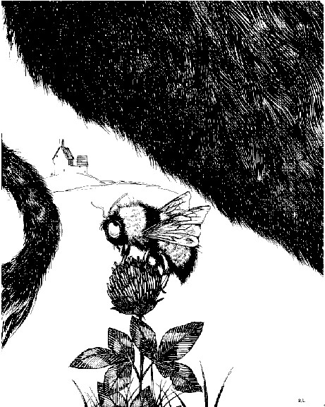
He didn’t look where he was sitting and instead of sitting on the nice cool grass in the shade he sat on a bumble bee.

Slide 18
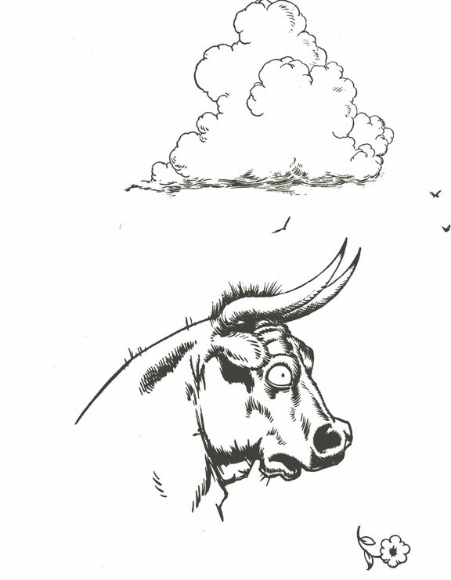
Well, if you were a bumble bee and a bull sat on you what would you do? You would sting him. And that is just what this bee did to Ferdinand.

Slide 19
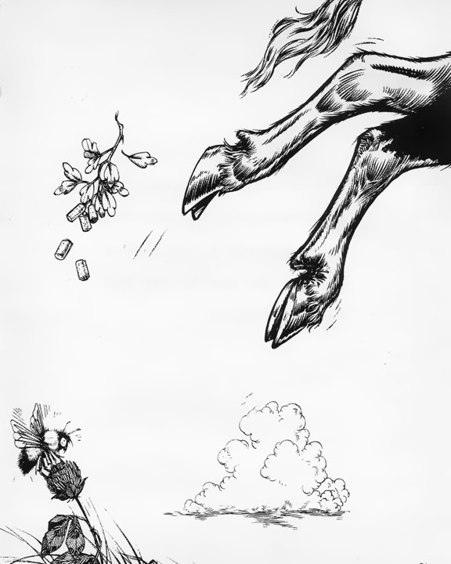
Wow! Did it hurt! Ferdinand jumped up with a snort. He ran around puffing and snorting, butting and pawing the ground as if he were crazy.

Slide 20
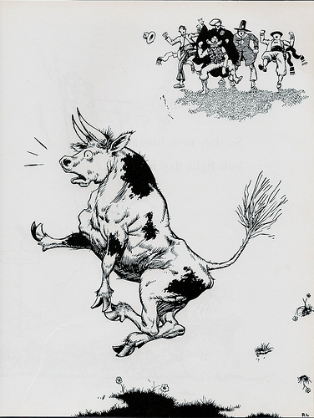
The five men saw him and they all shouted with joy. Here was the largest and fiercest bull of all. Just the one for the bull fights in Madrid.

Slide 21
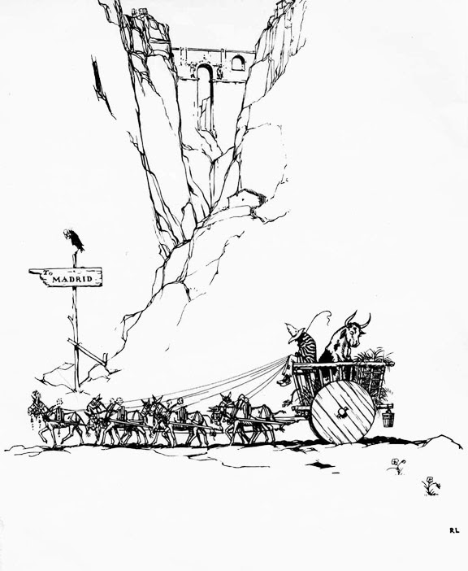
So they took him away for the bull fight day in a cart.

Slide 22
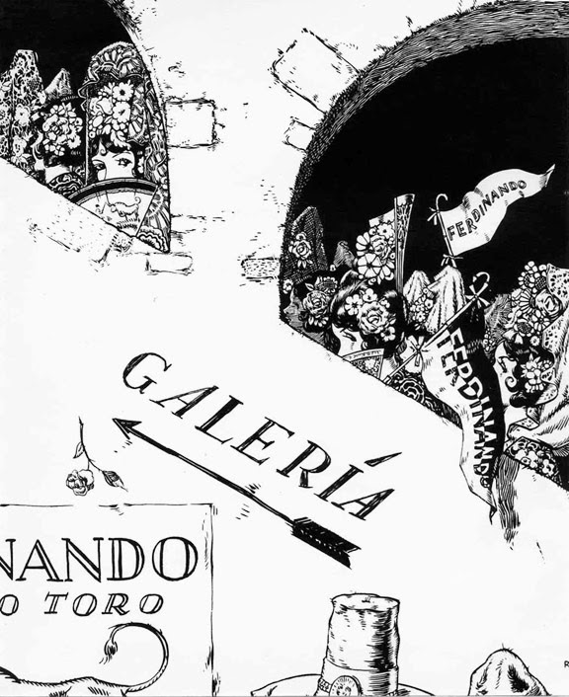
What a day it was! Flags were flying, bands were playing. . . and all the lovely ladies had flowers in their hair.

Slide 23
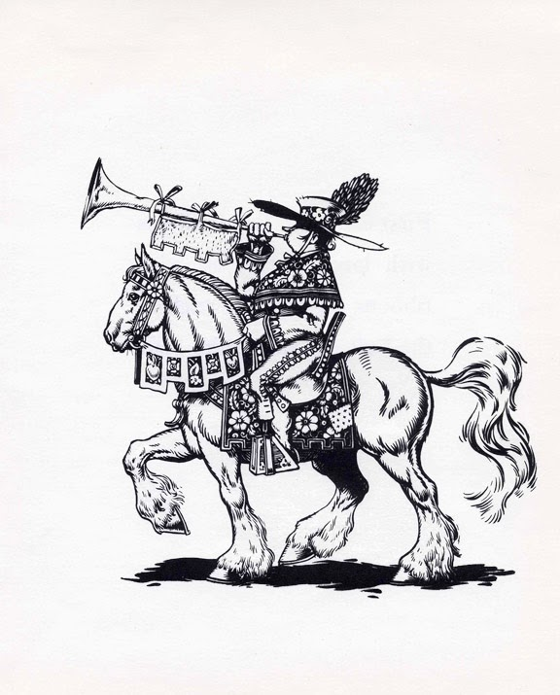
They had a parade into the bull ring. First came the Banderilleros who wanted to make the bull mad. Next came the Picadores who wanted to make the bull madder.

Slide 24
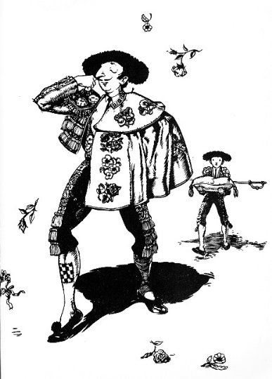
Then came the Matador, the proudest of all --- he thought he was very handsome, and bowed to the ladies. He had a red cape and was supposed to make the bull mad last of all.

Slide 25
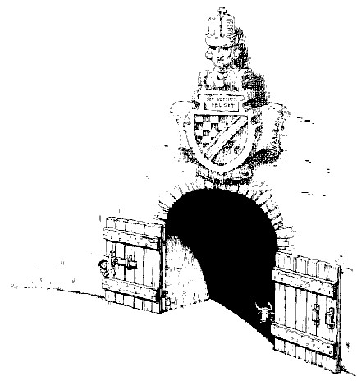
Then came the bull, and you know who that was don’t you? -FERDINAND!

Slide 26
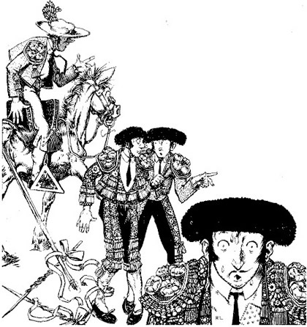
They called him Ferdinand the Fierce and all the Banderilleros were afraid of him and the Picadores were afraid of him and the Matador was scared stiff.

Slide 27
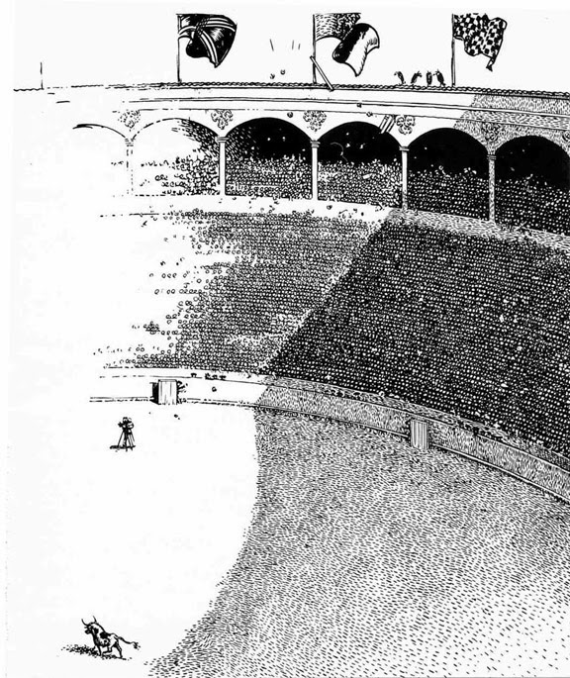
Ferdinand ran to the middle of the ring and everyone shouted and clapped because they thought he was going to fight fiercely and butt and snort and stick his horns around.

Slide 28
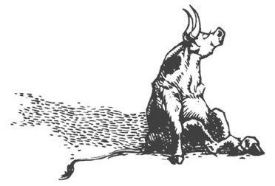
But not Ferdinand. When he got to the middle of the ring he saw the flowers in all the lovely ladies’ hair and he just sat down quietly and smelled.

Slide 29
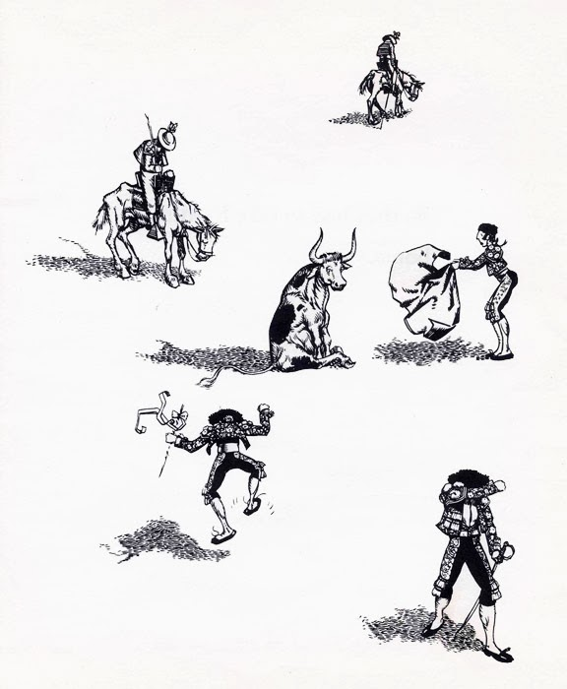
He wouldn’t fight and be fierce no matter what they did. He just sat and smelled. And the Banderilleros were mad and the Picadores were madder and the Matador was so mad he cried because he couldn’t show off with his cape.

Slide 30
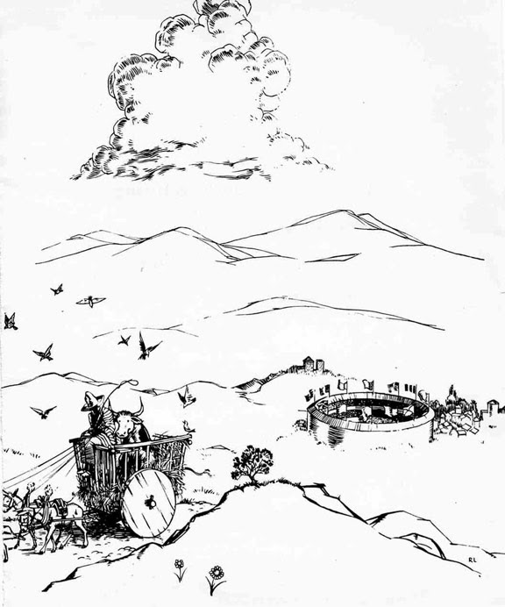
So they had to take Ferdinand home.

Slide 31
And for all I know he is sitting there still, under his favorite cork tree, smelling the flowers just quietly. He is very happy.

Slide 32
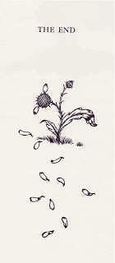
THE END

