Slide 1
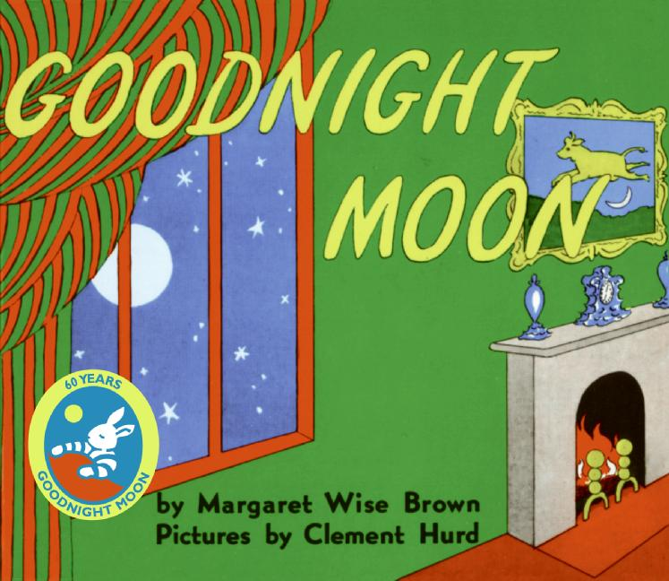


Slide 2
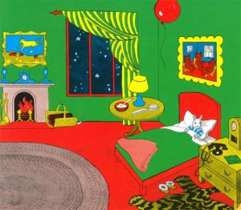
In the great green room

Slide 3


There was a telephone And a red balloon

Slide 4
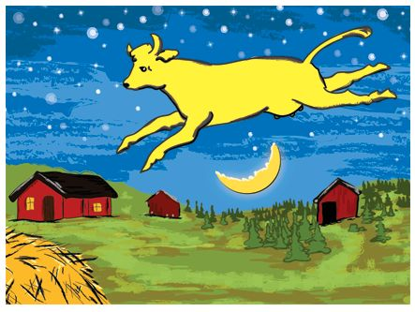
And a picture of the cow jumping over the moon

Slide 5
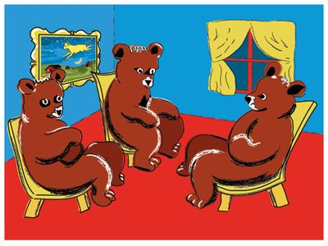
And there were three little bears sitting on chairs

Slide 6
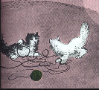
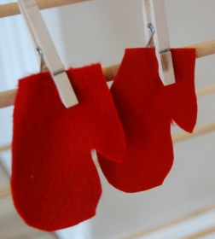
And two little kittens And a pair of mittens

Slide 7
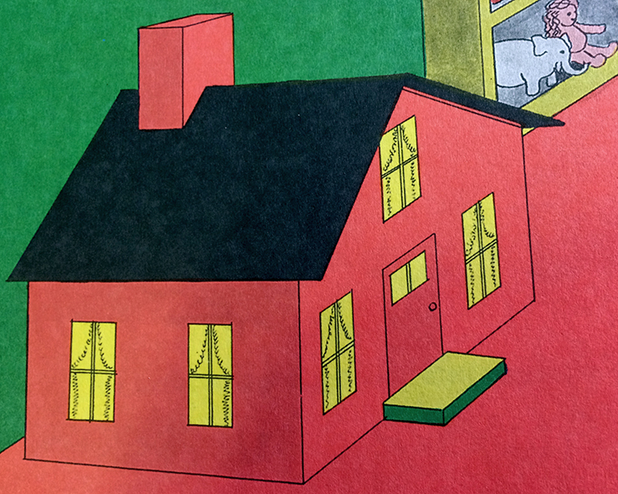

And a little toyhouse And a young mouse

Slide 8
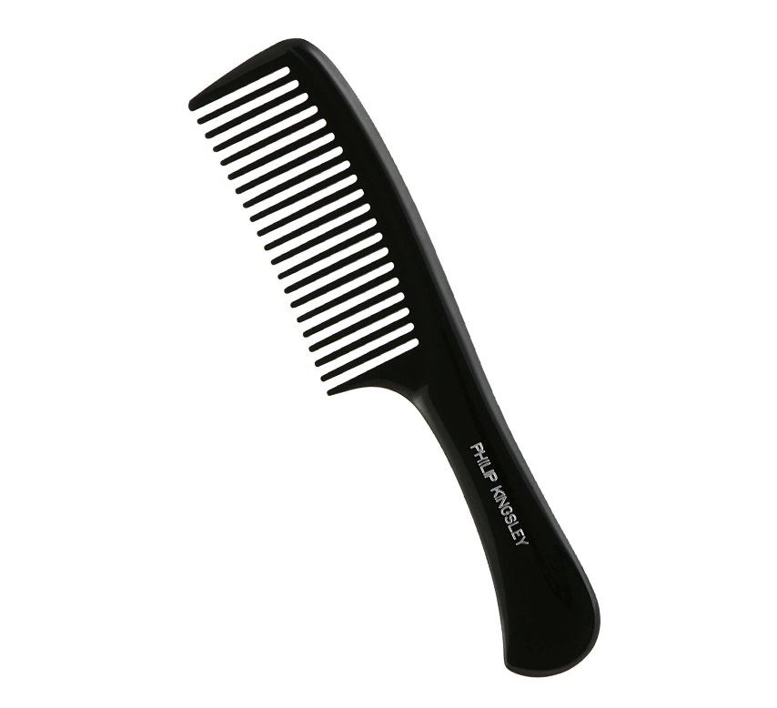
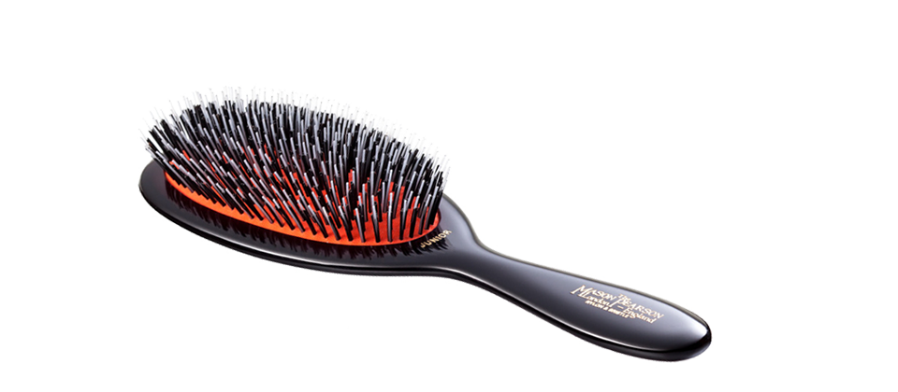

And a comb and a brush and a bowl full of mush

Slide 9
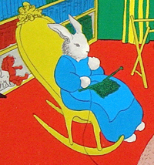
And a quiet old lady who was whispering “hush”

Slide 10
Goodnight room

Slide 11
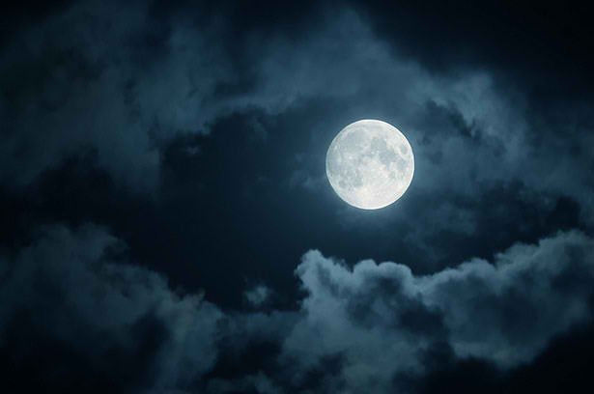
Goodnight moon

Slide 12
Goodnight cow jumping over the moon

Slide 13

Goodnight light And the red balloon

Slide 14
Goodnight bears Goodnight Chairs

Slide 15
Goodnight kittens And goodnight mittens

Slide 16
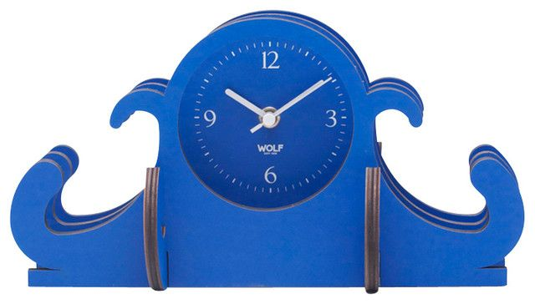

Goodnight clocks And goodnight socks

Slide 17
Goodnight little house And goodnight mouse

Slide 18
Goodnight comb And goodnight brush

Slide 19
Goodnight nobody Goodnight mush

Slide 20
And goodnight to the old lady whispering “hush”

Slide 21
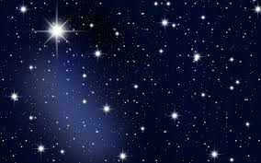
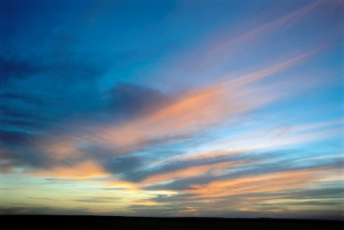
Goodnight stars Goodnight air

Slide 22
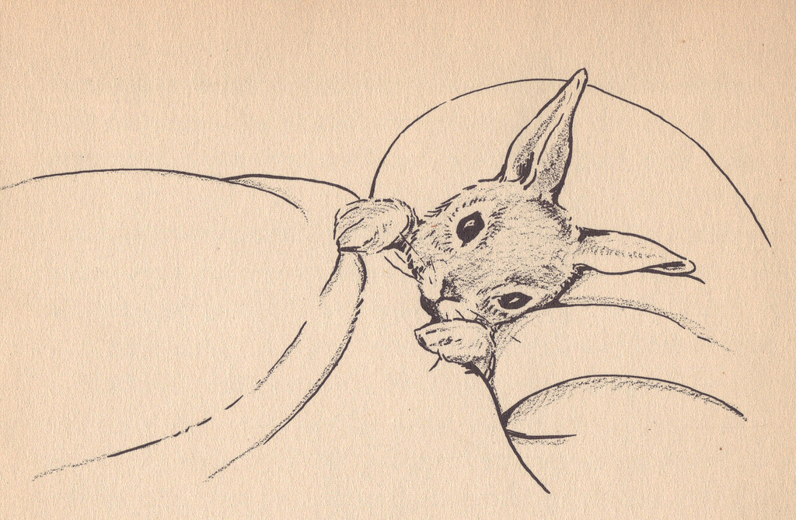
Goodnight noises everywhere

