Slide 1
Top Access Tips for Print Media

Slide 2
Print size
Print size 12 pt
Print size 14pt
Print size 18pt
Print size 24pt
Print size 36 pt
Print size 48pt

Slide 3
Typeface
Plain typeface
E.g.
Comic Sans
Arial

Slide 4
Bold text for emphasis only
Quarrel I will back thee.' Here the men are discussing whether it is a good idea to start the argument with the two other men, the answer is a yes and the two families quarrel and argue about who is the better man. "But if you do sir, I am for you, I serve as a good man a man of you"
The argument continues as Benvolio enters the scene, and moments later so does Tybalt,

Slide 5
Use plain text if possible and bold for highlighting text
Quarrel I will back thee.' Here the men are discussing whether it is a good idea to start the argument with the two other men, the answer is a yes and the two families quarrel and argue about who is the better man.
"But if you do sir, I am for you, I serve as a good man a man of you"
The argument continues as Benvolio enters the scene, and moments
later so does Tybalt,

Slide 6
Avoid Italics
Quarrel I will back thee.' Here the men are discussing whether it is a good idea to start the argument with the two other men, the answer is a yes and the two families quarrel and argue about who is the better man. "But if you do sir, I am for you, I serve as a good man a man of you"
The argument continues as Benvolio enters the scene, and moments
later so does Tybalt,

Slide 7
Avoid underlining
Quarrel I will back thee.' Here the men are discussing whether it is a good idea to start the argument with the two other men, the answer is a yes and the two families quarrel and argue about who is the better man. "But if you do sir, I am for you, I serve as a good man a man of you"
The argument continues as Benvolio enters the scene, and moments
later so does Tybalt, .

Slide 8
Use single or 1.5 – 2 line spacing (depending on child’s needs)
Quarrel I will back thee.' Here the men
are discussing whether it is a good
idea to start the argument with the two
other men, the answer is a yes and the
two families quarrel and argue about

Slide 9
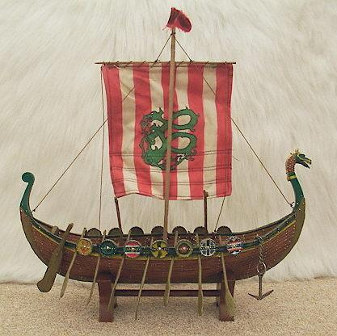
Positioning of text against image
Viking boats
Place the image on the opposite page to the text.
Place captions in same location on each image.
Viking boat

