Slide 1
We’re Going on a Bear Hunt
Michael Rosen Helen Oxenbury

Slide 2
We’re going on a bear hunt.
We’re going to catch a big one.
What a beautiful day!
We’re not scared.

Slide 3
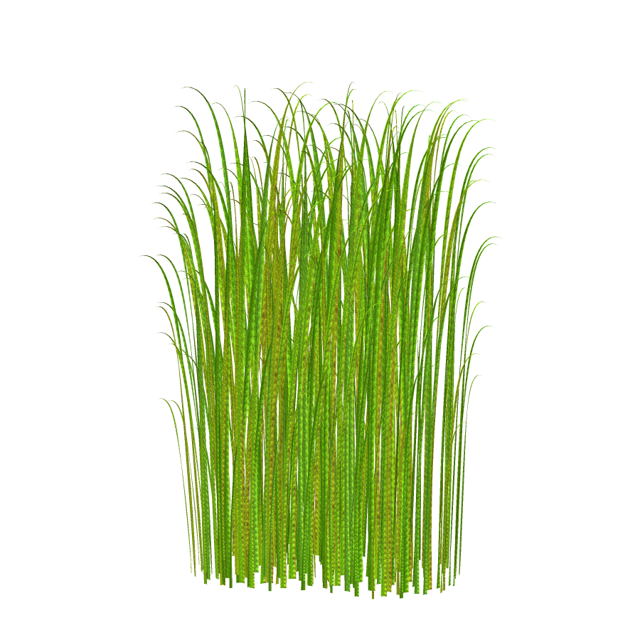
Oh-oh! Grass!
Long, wavy grass.
We can’t go over it.
We can’t go under it.
Oh, no!
We’ve got to go through it!
Swishy swashy!
Swishy swashy!
Swishy swashy!

Slide 4
We’re going on a bear hunt.
We’re going to catch a big one.
What a beautiful day!
We’re not scared.

Slide 5
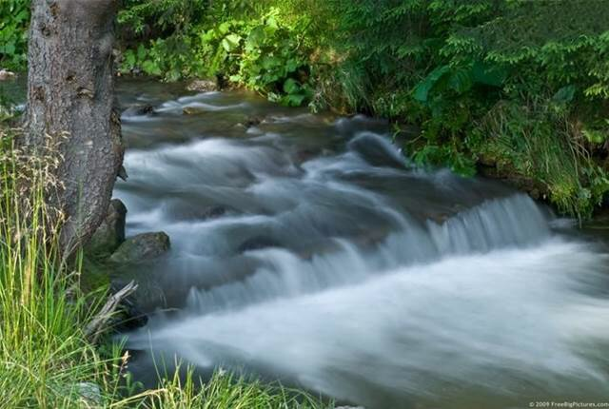
Oh-oh! A river!
A deep, cold river.
We can’t go over it.
We can’t go under it.
Oh, no!
We’ve got to go through it.
Splash splosh!
Splash Splosh!
Splash Splosh!

Slide 6
We’re going on a bear hunt.
We’re going to catch a big one.
What a beautiful day!
We’re not scared.

Slide 7
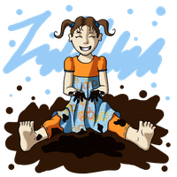
Oh-oh! Mud!
Thick, oozy mud!
We can’t go over it.
We can’t go under it.
Oh, no!
We’ve got to go through it!
Squelch squerch!
Squelch squerch!
Squelch squerch!

Slide 8
We’re going on a bear hunt.
We’re going to catch a big one.
What a beautiful day!
We’re not scared.

Slide 9
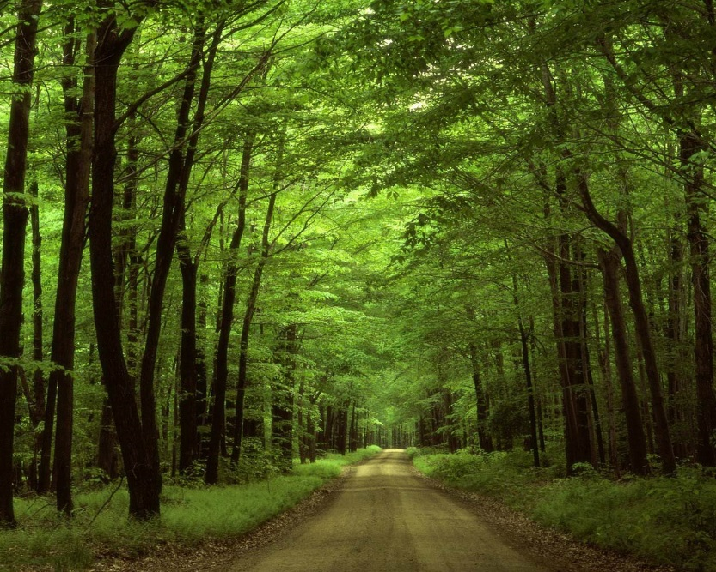
Oh-oh! A forest!
A big, dark forest.
We can’t go over it.
We can’t go under it.
Oh, no!
We’ve got to go through it!
Stumble trip!
Stumble trip!
Stumble trip!

Slide 10
We’re going on a bear hunt.
We’re going to catch a big one.
What a beautiful day!
We’re not scared.

Slide 11
Oh-oh! A snowstorm!
A swirling, whirling snowstorm.
We can’t go over it.
We can't go under it.
Oh, no!
We’ve got to go through it!
Hoooo Woooo!
Hoooo Woooo!
Hoooo Woooo!

Slide 12
We’re going on a bear hunt.
We’re going to catch a big one.
What a beautiful day!
We’re not scared.

Slide 13
Oh-no! A cave!
A narrow, gloomy cave.
We can’t go over it.
We can’t go under it.
Oh, no!
We’ve got to go through it!
Tiptoe!
Tiptoe!
Tiptoe!
WHAT’S THAT?

Slide 14
One shiny wet nose!
Two big furry ears!
Two big goggly eyes!
IT’S A BEAR!!!!

Slide 15
Quick! Back through the cave!
Tiptoe! Tiptoe! Tiptoe!
Back through the snowstorm!
Hoooo woooo! Hoooo woooo!
Back through the forest!
Stumble trip! Stumble trip!

Slide 16
Back through the mud!
Squelch squerch! Squelch squerch!
Back through the river!
Splash splosh! Splash splosh! Splash splosh!
Back through the grass!
Swishy swashy! Swishy swashy!

Slide 17
Get to our front door.
Open the door.
Up the stairs.
Oh, no!
We forgot to shut the door.
Back downstairs.

Slide 18
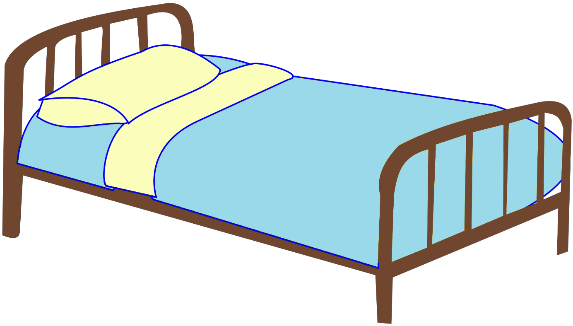
Shut the door.
Back upstairs.
Into the bedroom.
Into bed.
Under the covers.

Slide 19
We’re not going on a bear hunt again.

