Slide 1
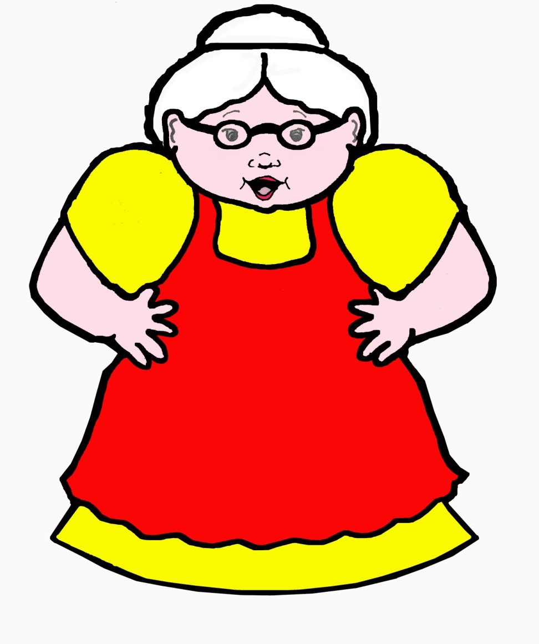
There Was An Old Lady . . . By Lucille Colandro

Slide 2
There was an old lady who swallowed some books.
I don’t know why she swallowed those books,
But she didn’t get any looks.

Slide 3
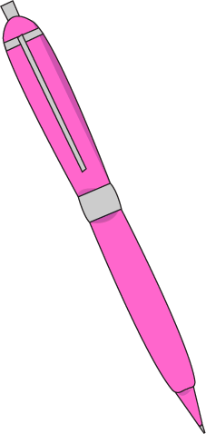
There was an old lady who swallowed a pen.
She was happy again when she swallowed that pen.
She swallowed the pen to write in the books.
I don’t know why she swallowed the books,
but she didn’t get any looks.

Slide 4
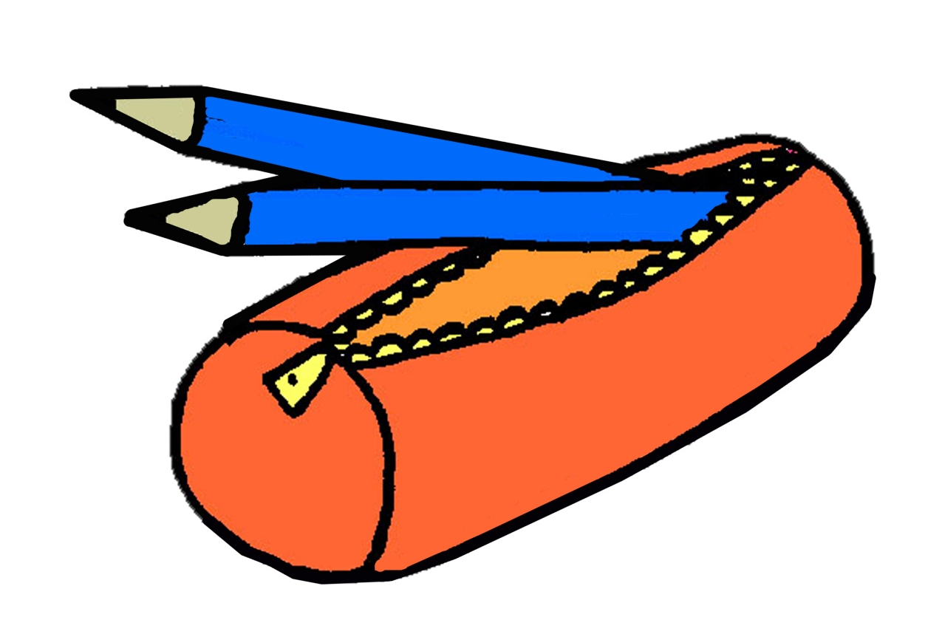
There was an old lady who swallowed a pencil case.
Without leaving a trace, she swallowed that pencil case.
She swallowed the pencil case to hold the pen.

Slide 5
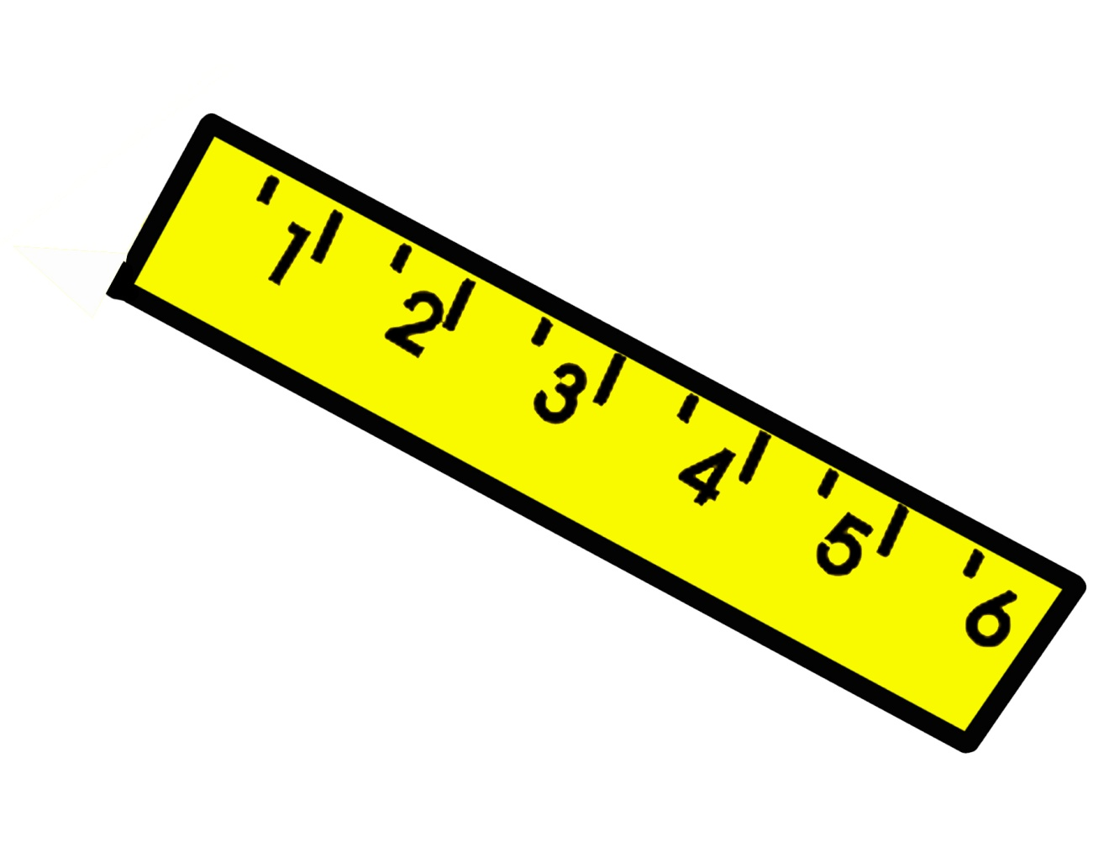
There was an old lady who swallowed a ruler.
She couldn’t look cooler swallowing that ruler.
She swallowed the ruler to measure the pencil case.

Slide 6
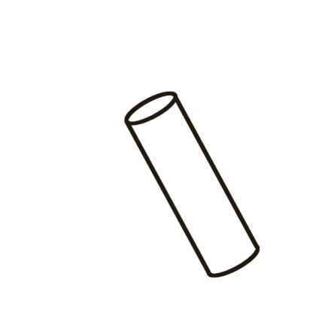
There was an old lady who swallowed a folder.
She didn’t feel any older when she swallowed the folder.
She swallowed the folder to protect the ruler.

Slide 7
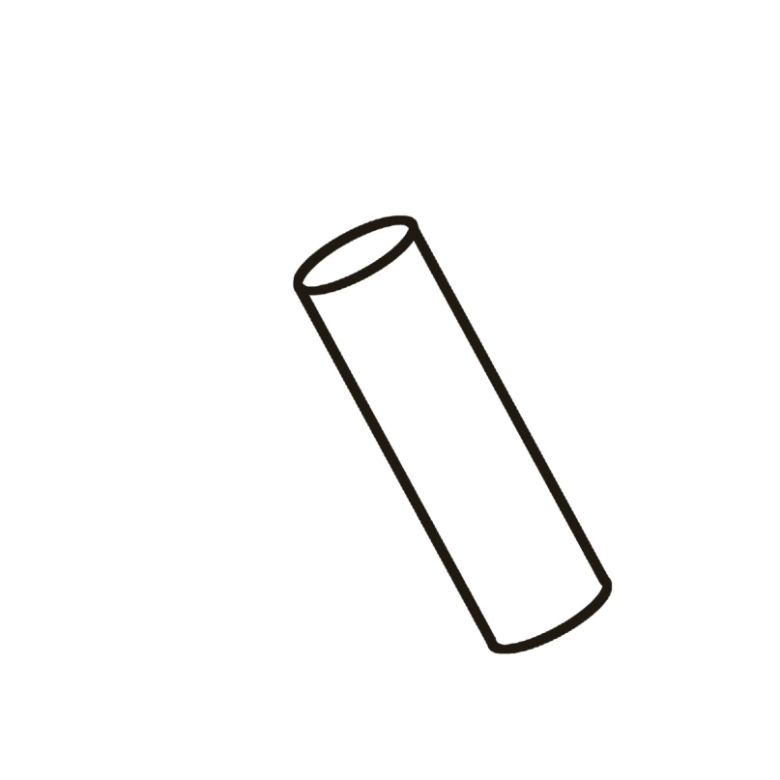
There was an old lady who swallowed some chalk.
She didn’t bawk when she swallowed that chalk.
She swallowed the chalk to decorate the folder.

Slide 8
There was an old lady who swallowed a bag.
She didn’t brag when she swallowed that bag.
She swallowed the bag to hold the chalk.

Slide 9
She swallowed the chalk to decorate the folder.
She swallowed the folder to protect the ruler.
She swallowed the ruler to measure the pencil case.
She swallowed the pencil case to hold the pen.
She swallowed the pen to write in the books.
I don’t know why she swallowed the books,
but she didn’t get any looks.

Slide 10
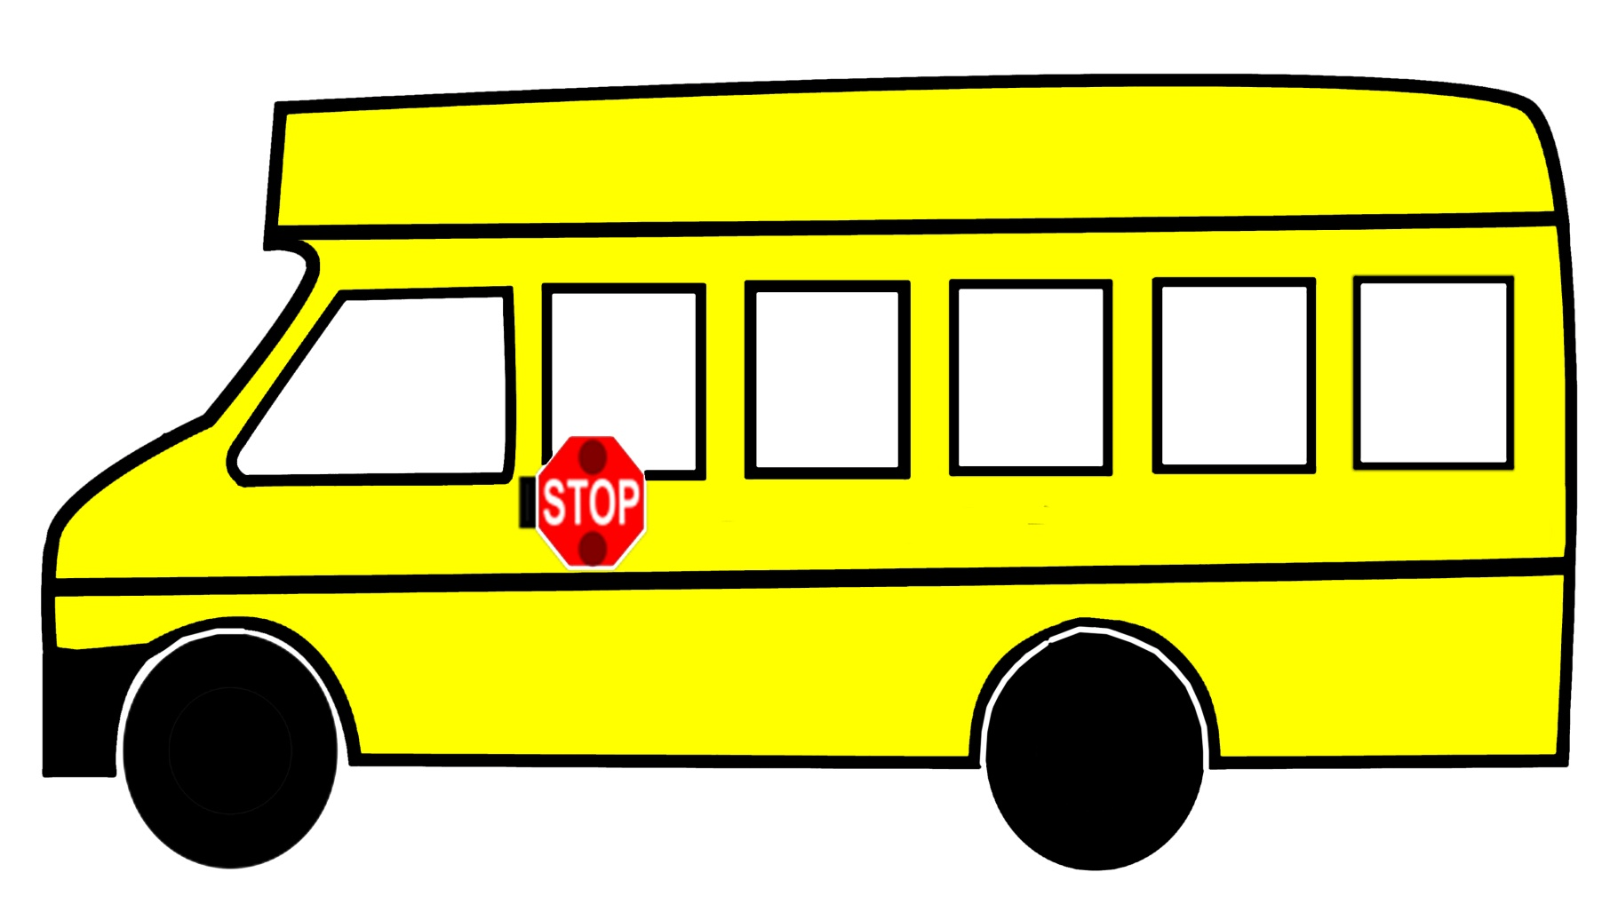
The old lady didn’t fuss
When around the corner came a big school bus.

Slide 11
She started a cheer that she could not hold back
and out popped her brand-new backpack.

Slide 12
Have a
great
school year!

